Slide 1
Overlapping Semicircles
Source: Catriona Shearer (twitter)
but seen before

Slide 2
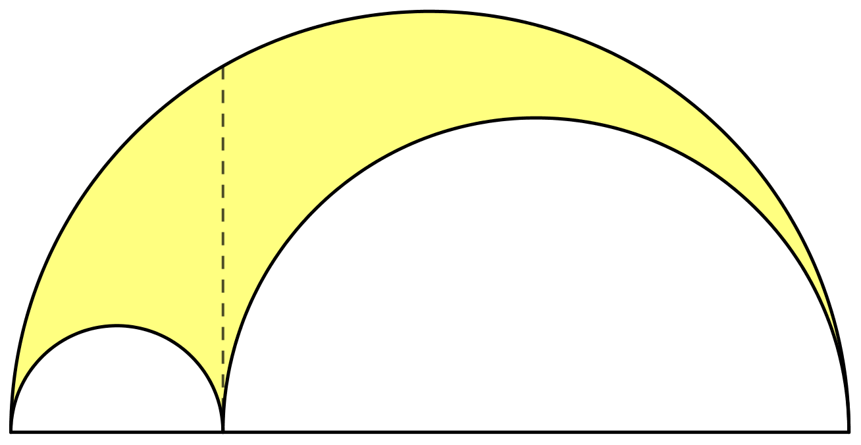


Overlapping Semicircles
$$2$$
$$\frac{2}{7}$$
(Not to scale)
In the diagram all arcs are semicircles and two lengths are shown.
What is the value of the shaded area?

Slide 3

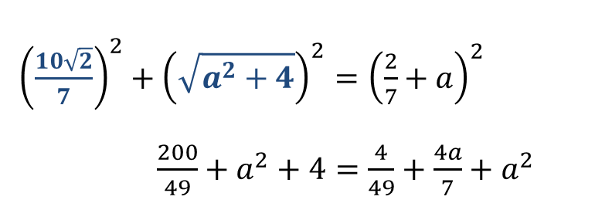




Overlapping Semicircles
Method 1:
Circle Theorem,
Pyhtagoras
$$\frac{10\sqrt{2}}{7}$$
$$\sqrt{a^{2}+4}$$
$$2$$
$$\frac{2}{7}$$
$$a$$
${\left(\frac{10\sqrt{2}}{7}\right)}^{2}+{\left(\sqrt{a^{2}+4}\right)}^{2}={\left(\frac{2}{7}+a\right)}^{2}$
$\frac{200}{49}+a^{2}+4=\frac{4}{49}+\frac{4a}{7}+a^{2}$
$$a=14$$

Slide 4
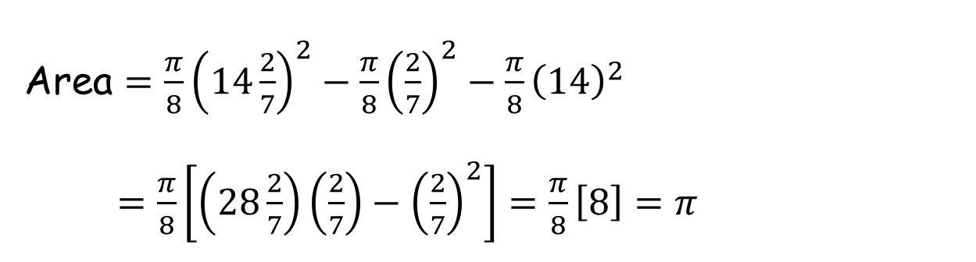


Overlapping Semicircles
Method 1:
$$π$$
$$\frac{2}{7}$$
$$14$$
Area $=\frac{π}{8}{\left(14\frac{2}{7}\right)}^{2}−\frac{π}{8}{\left(\frac{2}{7}\right)}^{2}−\frac{π}{8}{\left(14\right)}^{2}$
$=\frac{π}{8}\left[\left(28\frac{2}{7}\right)\left(\frac{2}{7}\right)−{\left(\frac{2}{7}\right)}^{2}\right]=\frac{π}{8}\left[8\right]=π$

Slide 5


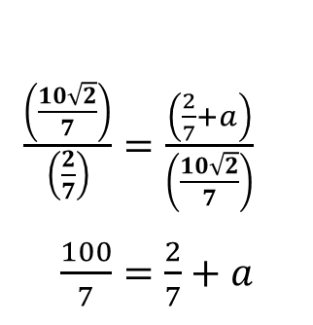
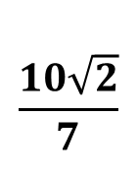

Overlapping Semicircles
Method 2:
Circle Theorem,
Pythagoras,
Similarity.
$$\frac{10\sqrt{2}}{7}$$
$$\sqrt{a^{2}+4}$$
$$2$$
$$\frac{2}{7}$$
$$a$$
$\frac{\left(\frac{10\sqrt{2}}{7}\right)}{\left(\frac{2}{7}\right)}=\frac{\left(\frac{2}{7}+a\right)}{\left(\frac{10\sqrt{2}}{7}\right)}$
$\frac{100}{7}=\frac{2}{7}+a$
$$\frac{2}{7}$$
$$2$$
$a=14$, as before
$$\frac{10\sqrt{2}}{7}$$

Slide 6




Overlapping Semicircles
$$c$$
$$b$$
$$a$$
Everyone should get the same answer - $π$.
Use the variables above to prove that fact.

Slide 7
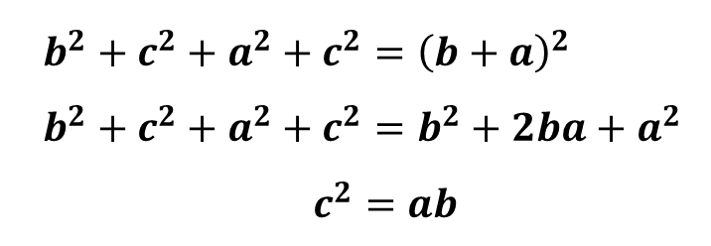




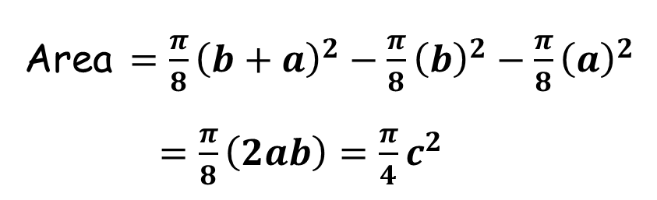
Overlapping Semicircles
$$\sqrt{a^{2}+c^{2}}$$
$$\sqrt{b^{2}+c^{2}}$$
$$c$$
$$b$$
$$a$$
$b^{2}+c^{2}+a^{2}+c^{2}={\left(b+a\right)}^{2}$
$b^{2}+c^{2}+a^{2}+c^{2}=b^{2}+2ba+a^{2}$
$c^{2}=ab$
Area $=\frac{π}{8}{\left(b+a\right)}^{2}−\frac{π}{8}{\left(b\right)}^{2}−\frac{π}{8}{\left(a\right)}^{2}$
$=\frac{π}{8}\left(2ab\right)=\frac{π}{4}c^{2}$

Slide 8





Overlapping Semicircles
Method 3:
Intersecting
Chords Theorem
There is another, more elegant way to prove this result.
$$c$$
$$b$$
$$a$$
$$b×a=c×c$$
$$ab=c^{2}$$
$$c$$

Slide 9
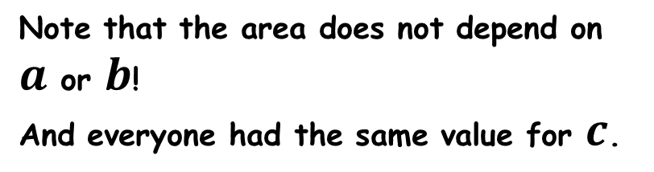
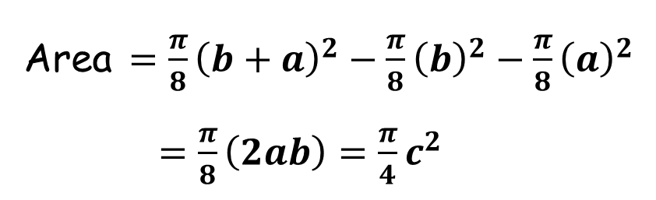

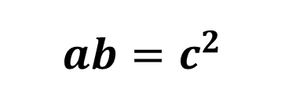

Overlapping Semicircles
Method 3:
Intersecting
Chords Theorem
There is another, more elegant way to prove this result.
$$π\left(\frac{c^{2}}{4}\right)$$
$$c$$
$$b$$
$$a$$
$$ab=c^{2}$$
Area $=\frac{π}{8}{\left(b+a\right)}^{2}−\frac{π}{8}{\left(b\right)}^{2}−\frac{π}{8}{\left(a\right)}^{2}$
$=\frac{π}{8}\left(2ab\right)=\frac{π}{4}c^{2}$
Note that the area does not depend on $a$ or $b$!
And everyone had the same value for $c$.

Slide 11
RESOURCES

Slide 12
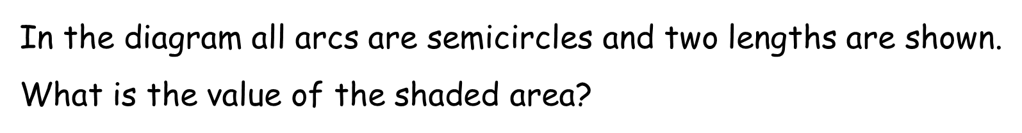

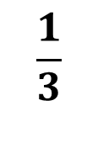
Overlapping Semicircles
SIC_73
$$A$$
$$2$$
$$\frac{1}{3}$$
(Not to scale)

Slide 13

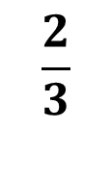
Overlapping Semicircles
SIC_73
$$B$$
$$2$$
$$\frac{2}{3}$$
(Not to scale)

Slide 14

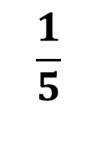
Overlapping Semicircles
SIC_73
$$C$$
$$2$$
$$\frac{1}{5}$$
(Not to scale)

Slide 15

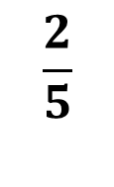
Overlapping Semicircles
SIC_73
$$D$$
$$2$$
$$\frac{2}{5}$$
(Not to scale)

Slide 16

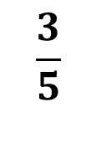
Overlapping Semicircles
SIC_73
$$E$$
$$2$$
$$\frac{3}{5}$$
(Not to scale)

Slide 17

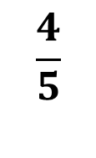
Overlapping Semicircles
SIC_73
$$F$$
$$2$$
$$\frac{4}{5}$$
(Not to scale)

Slide 18


Overlapping Semicircles
SIC_73
$$G$$
$$2$$
$$\frac{1}{7}$$
(Not to scale)

Slide 19


Overlapping Semicircles
SIC_73
$$H$$
$$2$$
$$\frac{3}{7}$$
(Not to scale)

Slide 20


Overlapping Semicircles
SIC_73
$$I$$
$$2$$
$$\frac{4}{7}$$
(Not to scale)

Slide 21


Overlapping Semicircles
SIC_73
$$J$$
$$2$$
$$\frac{5}{7}$$
(Not to scale)

Slide 22


Overlapping Semicircles
SIC_73
$$K$$
$$2$$
$$\frac{6}{7}$$
(Not to scale)

Slide 23

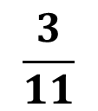
Overlapping Semicircles
SIC_73
$$L$$
$$2$$
$$\frac{3}{11}$$
(Not to scale)

Slide 24


Overlapping Semicircles
SIC_73
$$M$$
$$2$$
$$\frac{3}{2}$$
(Not to scale)

Slide 25


Overlapping Semicircles
SIC_73
$$N$$
$$2$$
$$\frac{5}{3}$$
(Not to scale)

Slide 26


Overlapping Semicircles
SIC_73
$$O$$
$$2$$
$$\frac{5}{4}$$
(Not to scale)

Slide 27


Overlapping Semicircles
SIC_73
$$P$$
$$2$$
$$\frac{7}{4}$$
(Not to scale)

Slide 28

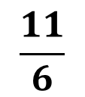
Overlapping Semicircles
SIC_73
$$Q$$
$$2$$
$$\frac{11}{6}$$
(Not to scale)

Slide 29

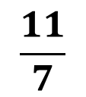
Overlapping Semicircles
SIC_73
$$R$$
$$2$$
$$\frac{11}{7}$$
(Not to scale)

Slide 30

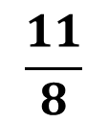
Overlapping Semicircles
SIC_73
$$S$$
$$2$$
$$\frac{11}{8}$$
(Not to scale)

Slide 31

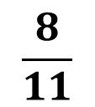
Overlapping Semicircles
SIC_73
$$T$$
$$2$$
$$\frac{8}{11}$$
(Not to scale)

Slide 32

Overlapping Semicircles
SIC_73
$$c$$
$$b$$
$$a$$
(Not to scale)

Slide 33
Overlapping Semicircles
SIC_73
$$c$$
$$b$$
$$a$$
(Not to scale)

Slide 34
Overlapping Semicircles
SIC_73
$$c$$
$$b$$
$$a$$
(Not to scale)

Slide 35
Overlapping Semicircles
SIC_73
$$c$$
$$b$$
$$a$$
(Not to scale)

